Slide 1
Software Analysis and Design (CS:3004)
Entity Control and Boundary Classes

Slide 2
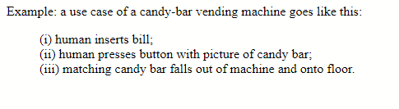
Use cases
When someone wants a machine built, they tell us how they want the machine to behave when they use it. They give us examples, and we develop the machine's structure and control from the examples.
An example behavior is called a use case.

Slide 3
ECB(Robustness Analysis):
The Robustness Analysis is a practice that originated with Ivar Jacobson’s Objectory Method. (also called Jacobson’s diagram)
This involves analyzing the narrative text of use cases, identifying the first-guess set of objects that will participate in those use cases, and classifying these objects based on the roles they play.
Robustness analysis helps you to bridge the gap from Use Cases and Domain Classes.

Slide 4
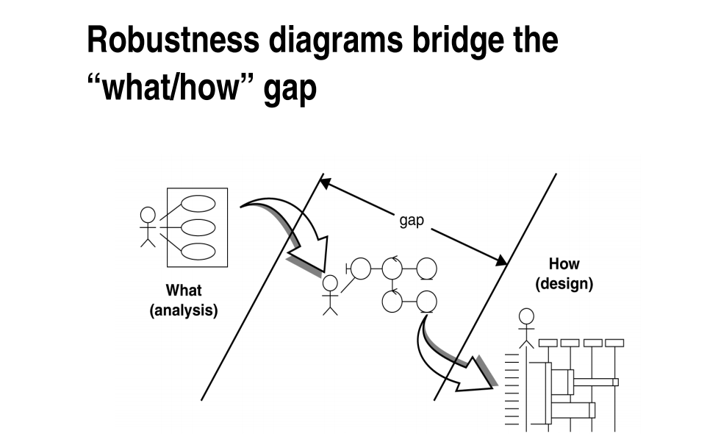

Slide 5
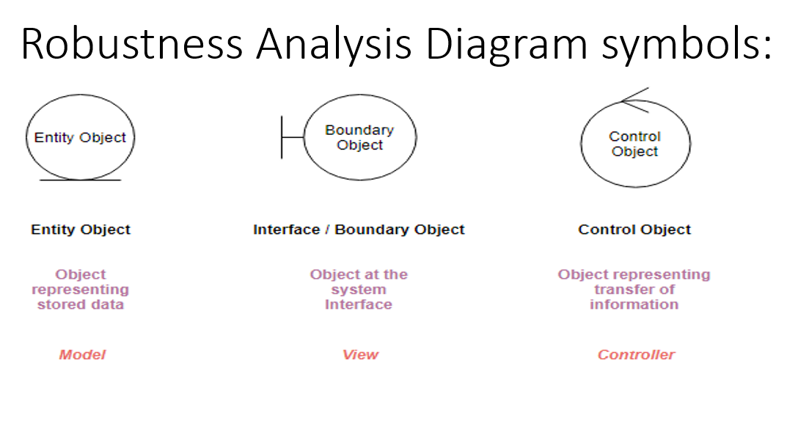
ECB partitions the system into three types of classes: entities, controls, and boundaries.
entity, control, and boundary are official UML class stereotypes. UML has some special icons to represent them.

Slide 6
Boundary object (or interface object) is what actors use in communicating with the system. The HTML, CSS, etc. which makes up the look and feel of the application
A boundary class intermediates between the interface and something outside the system.
Boundary classes insulate the system from changes in the surroundings

Slide 7
Entity object The persistent data that we keep in the data store. Entities are objects representing system data: Customer, Product, Transaction, Cart, etc.
The main responsibilities of entity classes are to store and manage information in the system. Entity Class always as environment independent.
Control objects (also known as controllers in MVC), which serve as the “glue” between boundary objects and entity objects. The code that does the thinking and decision making

Slide 8
What Is an Analysis Class?
A class that represents initial data and behavior requirements, and whose software and hardware- oriented details have not been specified

Slide 9
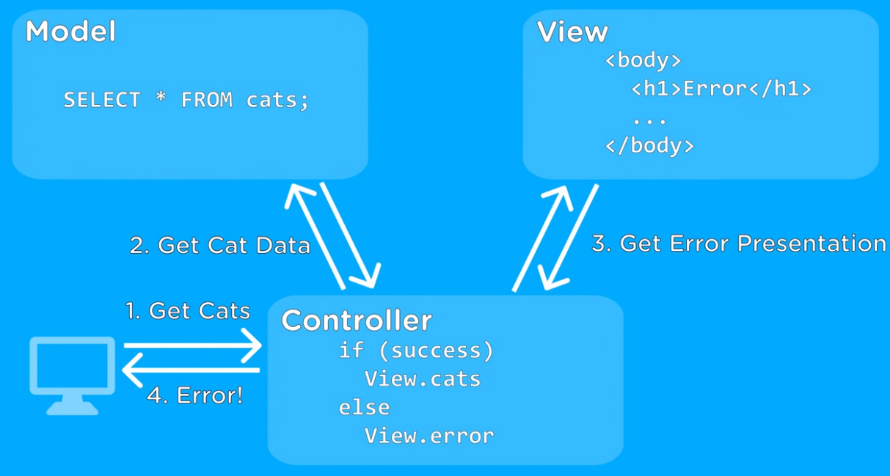
Model(entity) , Controller(control), View(boundary)

Slide 10
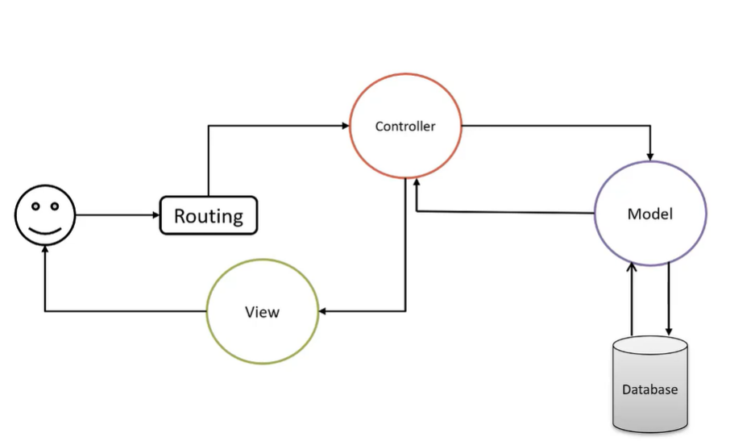

Slide 11
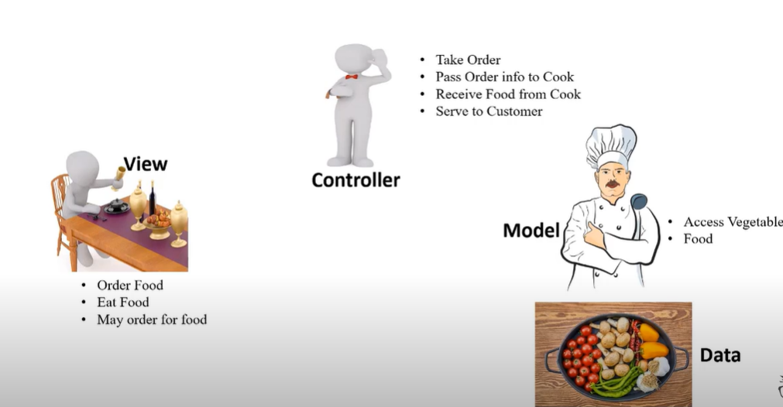

Slide 12
Several Types of Boundary Classes
User interface classes –
Classes that facilitate communication with human users of the system Menus, forms, etc. User interface classes.
System interface classes :
Classes which facilitate communications with other systems.
These boundary classes are responsible for managing the dialogue with the external system, like getting data from an existing database system or flat file.
Provides an interface to that system for this system
Device Interface Classes
Provide an interface to devices which detect external events – like a sensor or …
One boundary class per use case/actor pair

Slide 13
Robustness Diagram – 4 Connection Rules
Keep in mind that both boundary objects and entity objects are nouns and that controllers are verbs. Nouns can’t talk to other nouns, but verbs can talk to either nouns or verbs.
Here I listed the four basic connection rules which should always be mind:
Actors can only talk to boundary objects.
Boundary objects can only talk to controllers and actors.
Entity objects can only talk to controllers.
Controllers can talk to boundary objects and entity objects, and to other controllers, but not to actors.

Slide 14
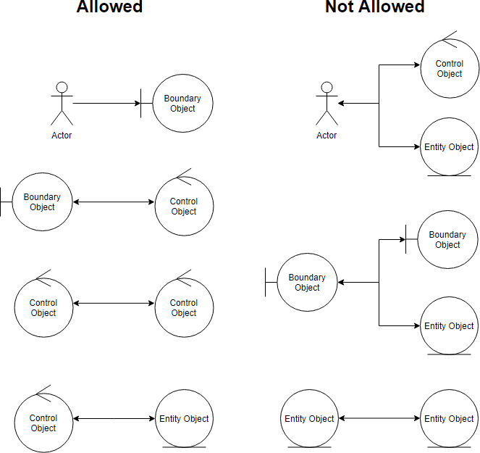
Robustness Analysis Diagram connection rules:

Slide 15
In the context of Entity Control and Boundary (ECB) modeling, entities are typically considered independent and self-contained. The primary idea behind ECB modeling is to define clear boundaries around entities and to control access to their attributes and behaviors.
Entities in ECB modeling don't directly link to or interact with other entities in the way that you might see in other modeling approaches like Entity-Relationship Diagrams (ERD) or Object-Oriented Modeling. Instead, ECB focuses on encapsulating the behavior and data of individual entities within well-defined boundaries.
If there's a need for entities to interact with each other, it is typically done through some kind of messaging or communication mechanism, where one entity sends a message or request to another entity. This message passing or interaction between entities can be defined and controlled within the ECB model, but it's not a direct linking of entities as you might see in other modeling paradigms.
The specific details of how entities interact within an ECB model can vary depending on the particular modeling framework or methodology being used. The key principle is to maintain clear boundaries and control over how entities communicate and share information while preserving their independence.

Slide 16
British University Management System
British University Management System is a smart, flexible, and affordable solution that covers all aspects of Universities, Colleges or Schools. It's a complete end-to-end solution that covers every minute aspect of a university workflow which we had used to perform manually.
There are four most important users who behave as Staff, Faculty, Administrator, and Student.
Student will use the system for course registration after proper login with creditionals student can also apply for scholarship on the basis on their financial status and merit.

Slide 17
British University Management System…
Office Staff are responsible for making class schedule for faculty members, then faculty members run their classes according to defined scheduled.
Faculty are responsible for assigning the grades and maintain the student’s attendance with proper creditionals and to achieve these objectives faculty portal offers two sub-portals such as, manage attendance and manage evaluation. They can also provide course feedback form in their account. Then all suitable changes are implemented from administration for upcoming semester.
Administrator who are responsible to control all the operations that are performed by different users.

Slide 18
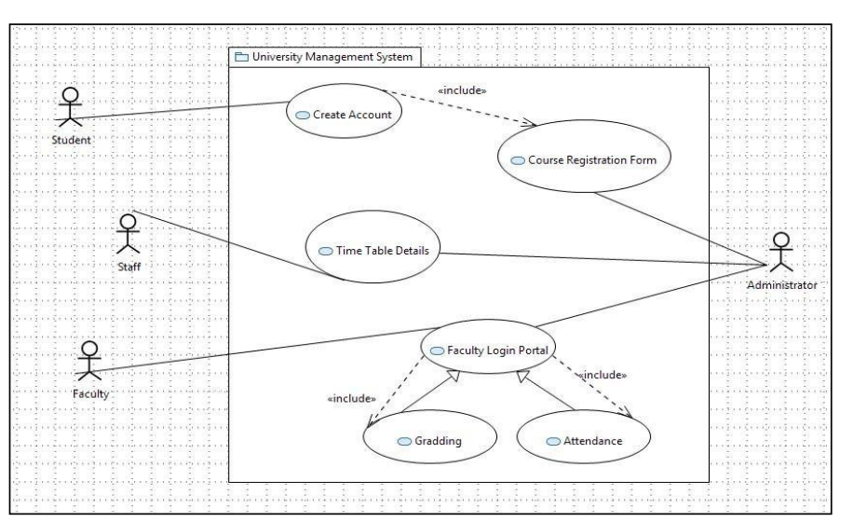
British University Management System USE CASE Diagram

Slide 19
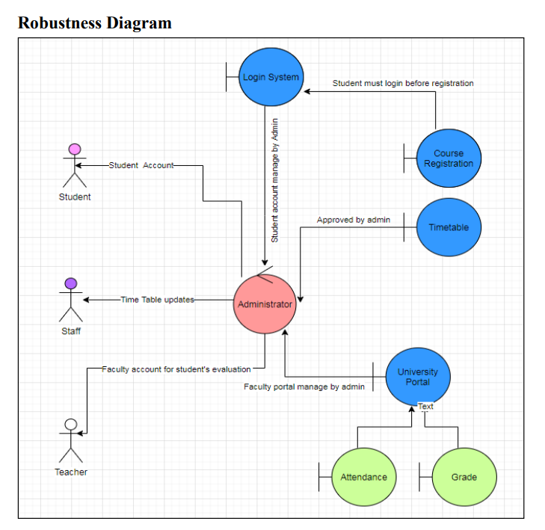

Slide 20
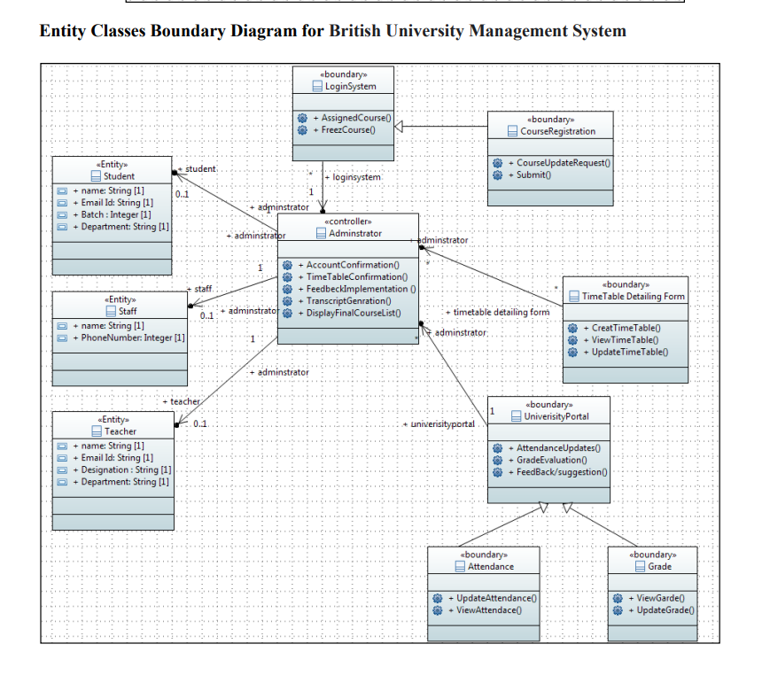

Slide 21
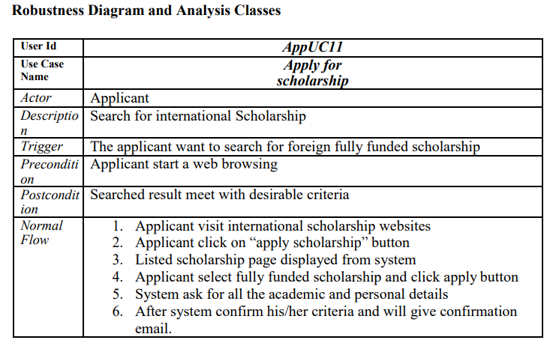

Slide 22
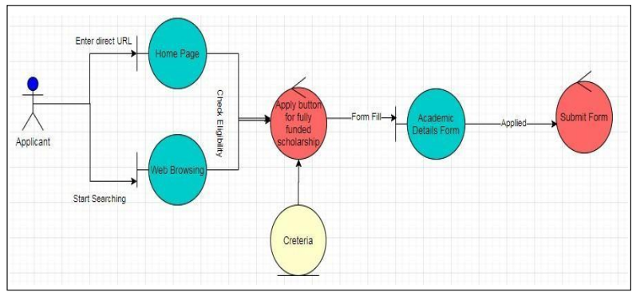

Slide 23
Use case ID | UC103
Use case Name | Search Products
Actors | Customer
Description | Search for products based on some criteria
 | The customer wants to browse among products or the customer would like to search for certain products
Precondition | Customer starts web browser
Postcondition | Search results meeting the criteria are displayed
Normal Flow | Customer visits the application home page Customer clicks the search button Search page is displayed by the system Customer enters search criteria The system validates the criteria provided The system looks up the catalog to find the products that meet the criteria Search results page is displayed with the product fulfilling the criteria
Alternative flows | Refine Search Results The following steps are added: Customer refines search results by providing additional criteria Step 5-7 are re-executed
Exceptions | In step 5, if search criteria is invalid or even missing then Step 3 (display search page) will be executed along with some hints on valid criteria Step 6, if no products found meet the criteria then Step 3 (display search page) will be executed along with the error message “Product not found”
Included | None
Notes and issues | None

Slide 24
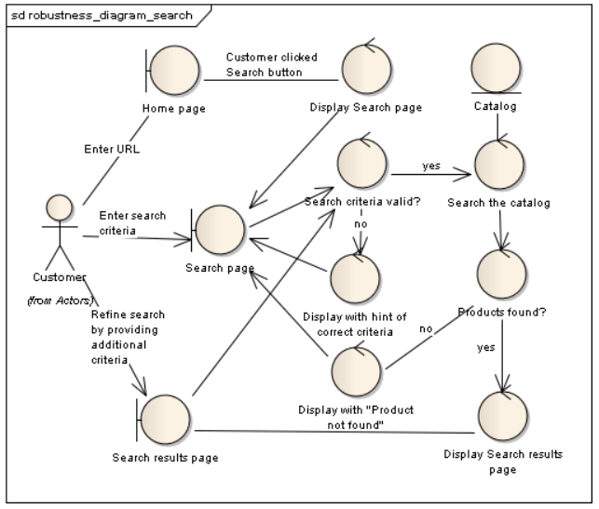
Robustness Diagram

Slide 25
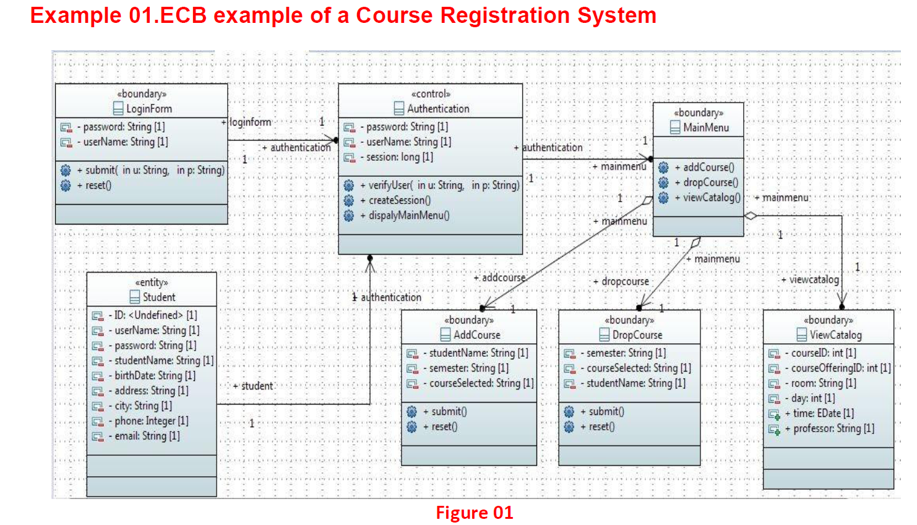

Slide 26
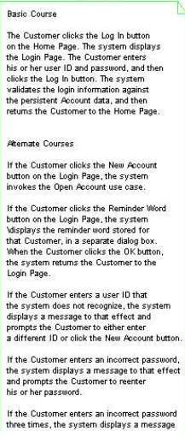
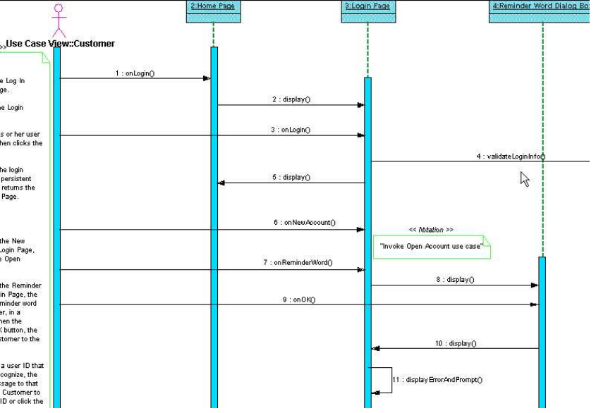
Login Sequence diagram:

Slide 27
Edit Shopping Cart use case text:
Basic Course:
On the Shopping Cart Page, the Customer modifies
the quantity of an Item in the Shopping Cart, and then presses the
Update button. The system stores the new quantity, and then
computes and displays the new cost for that Item.
Alternate Course:
If the Customer changes the quantity of the Item
to 0, the system deletes that Item from the Shopping Cart.

Slide 28
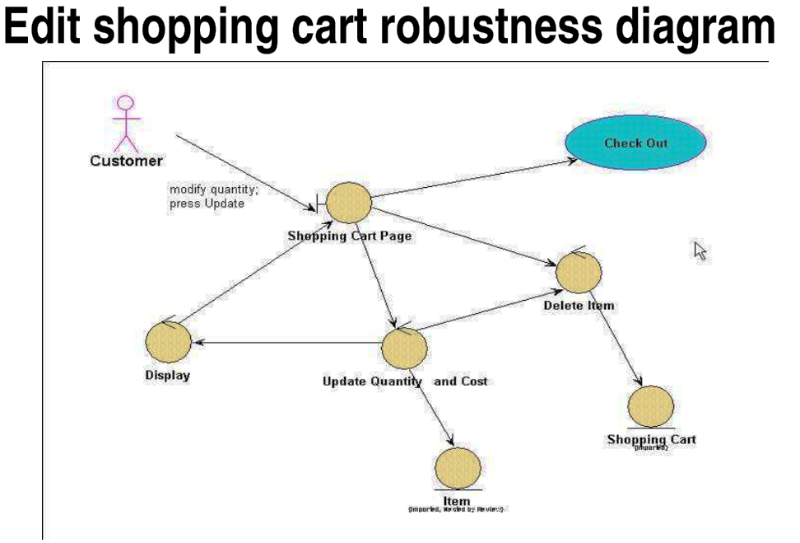

Slide 29
Five Steps for Creating Robustness Analysis:
You perform robustness analysis for a use case by walking through the use case text.
One sentence at a time, and drawing the actors, the appropriate boundary, entity objects and controllers, and the connections among the various elements of the diagram.
You should be able to fit the basic course and all of the alternate courses on one diagram.
Anyone who reviews a robustness diagram should be able to read a course of action in the use case text, trace his finger along with the associations on the diagram, and see a clear match between text and picture.

Slide 30
